Slide 1
MANUFACTURED & MODULAR HOUSING: QUALITY, AFFORDABILITY, ENERGY EFFICIENCY
Suburban Collection Showplace
Novi, MI

Slide 2
John D. Lindley, President & CEO Michigan Manufactured Housing Association
Suburban Collection Showplace
Novi, MI

Slide 3
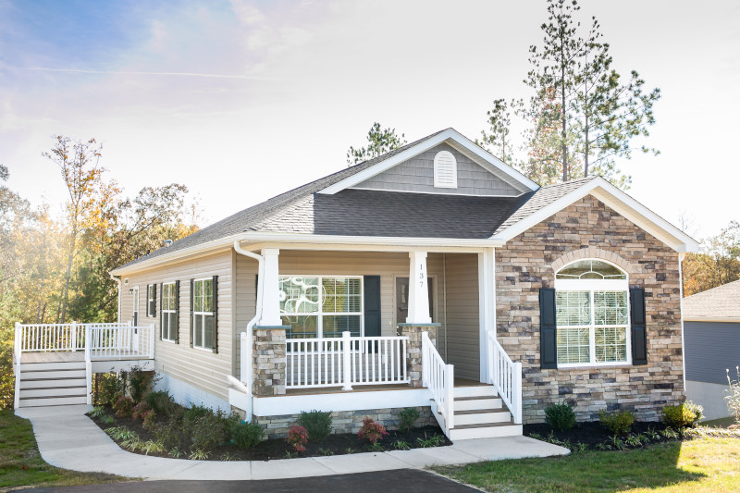
Modular (State Code)
Suburban Collection Showplace
BUILDING MICHIGAN COMMUNITIES CONFERENCE Novi, MI

Slide 4
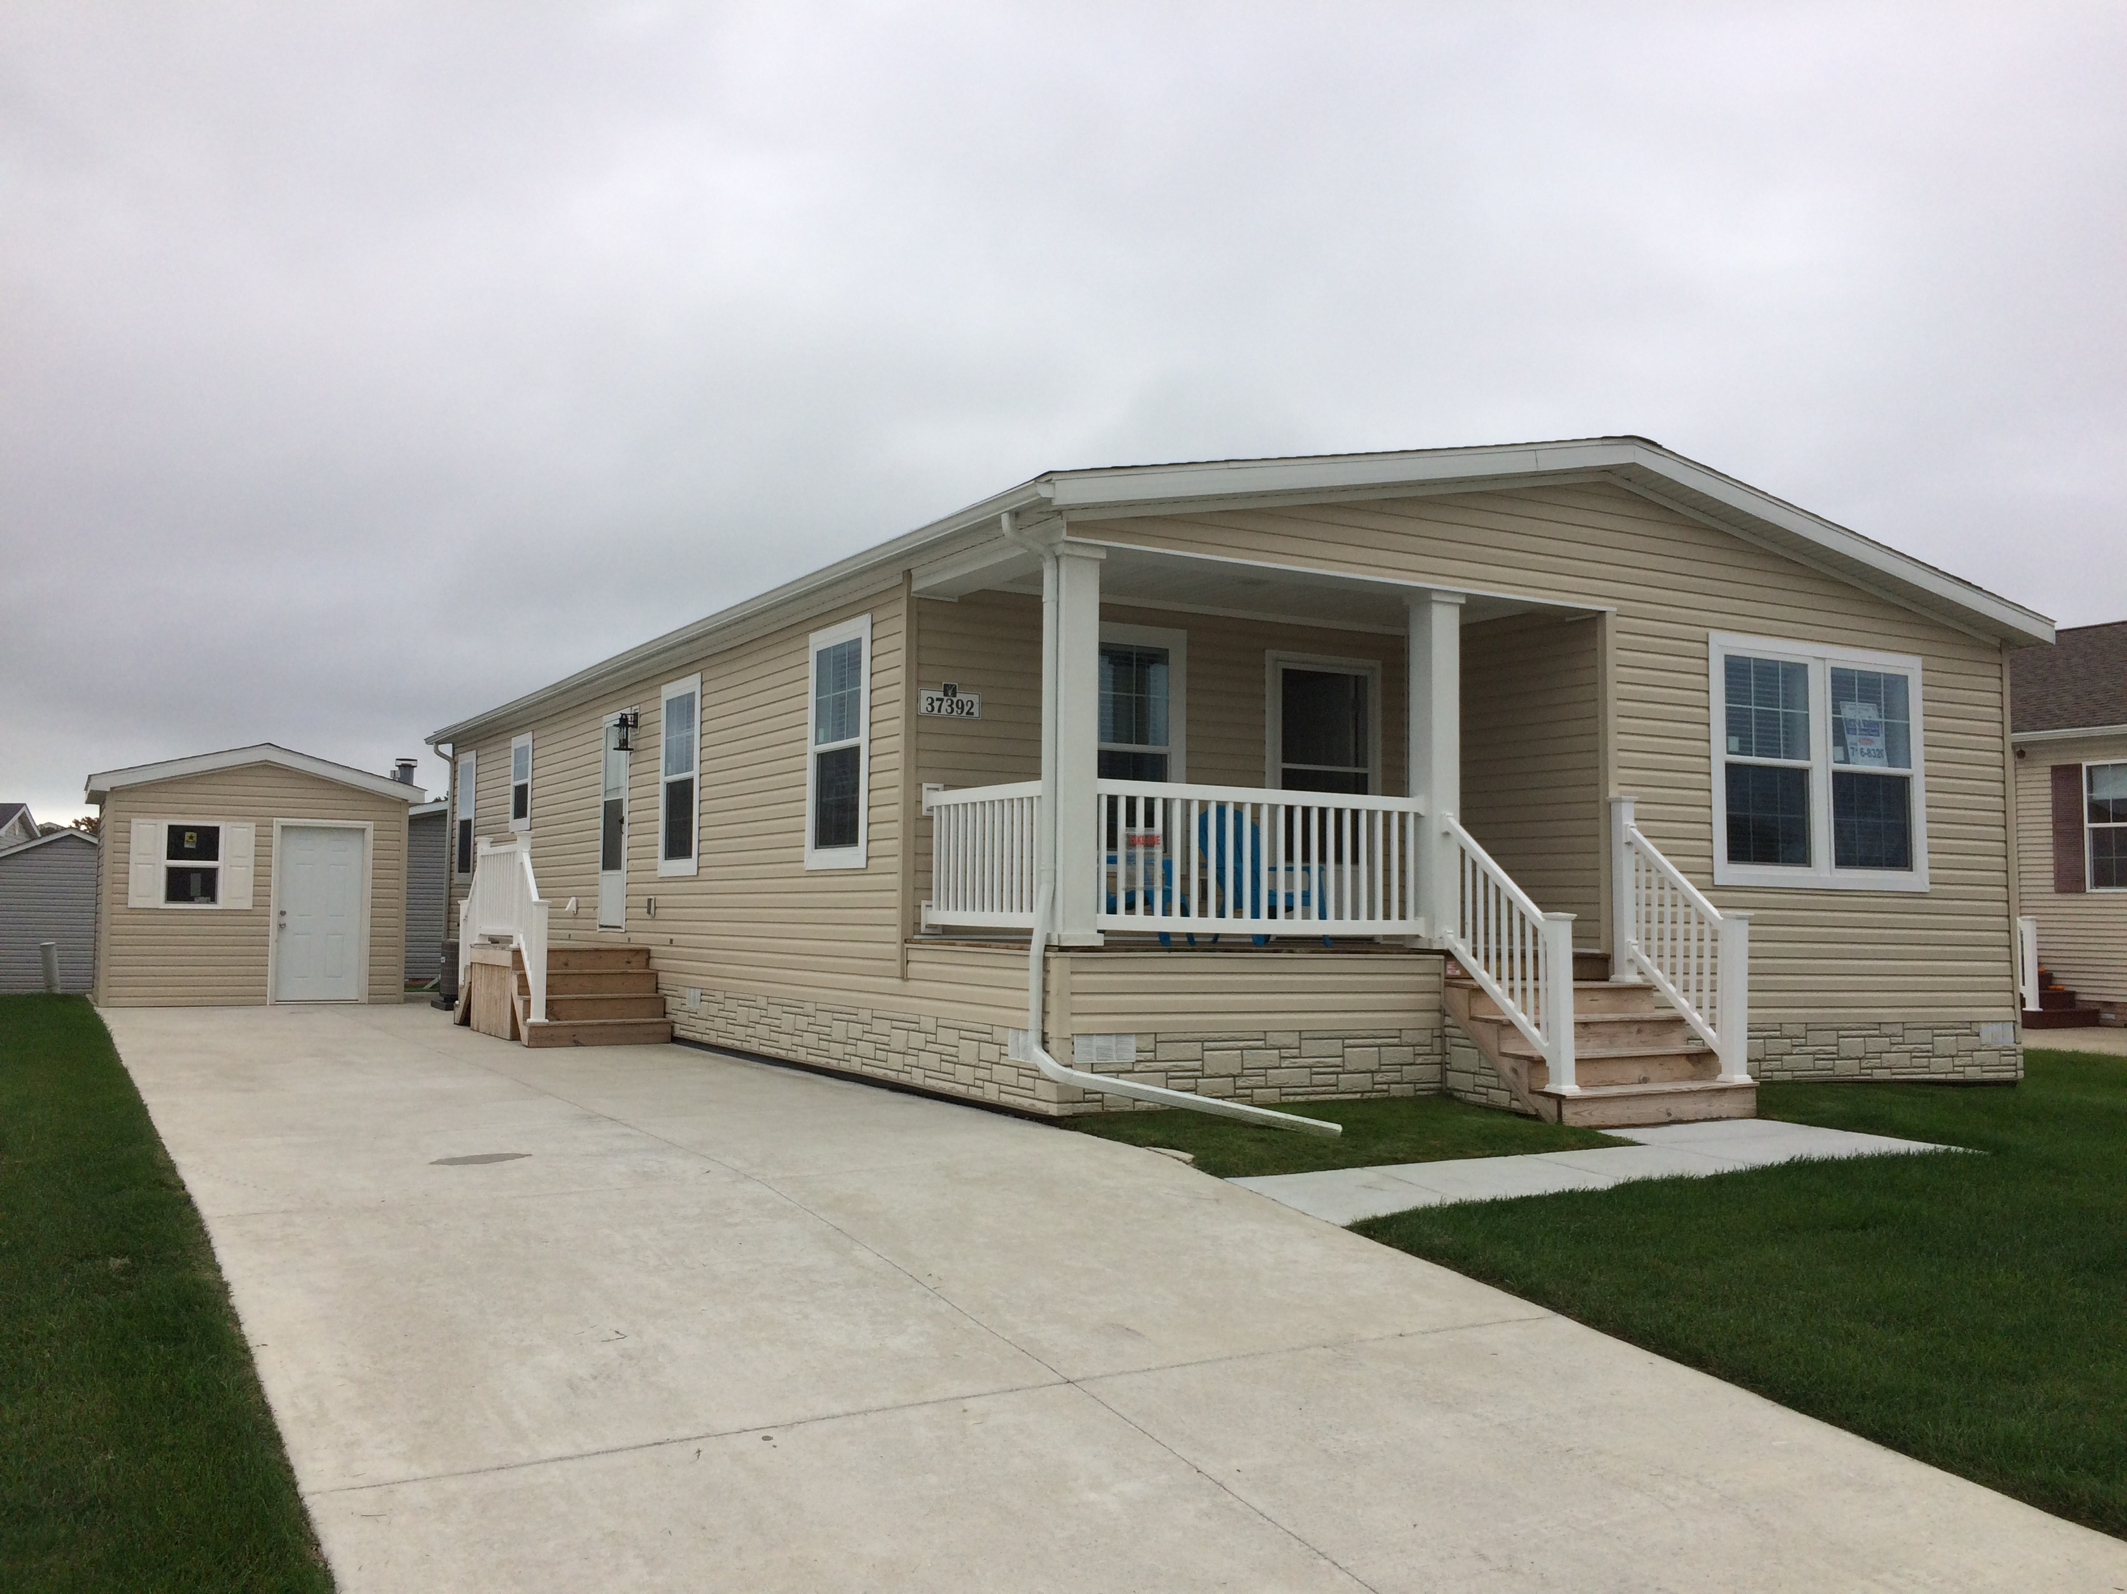
Manufactured (HUD Code)
Suburban Collection Showplace
BUILDING MICHIGAN COMMUNITIES CONNovi, MI

Slide 5
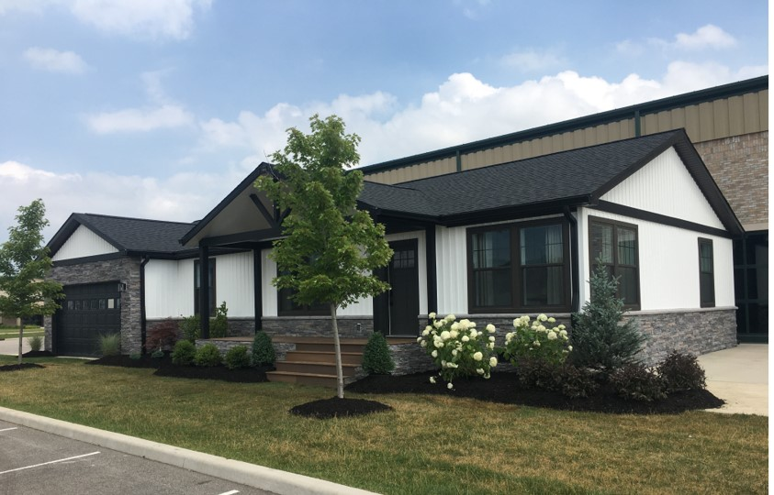
Cross Mod
Suburban Collection Showplace
BUILDING MICHIGAN COMMUNITIES CONNovi, MI

Slide 25
Energy Efficiency

Slide 27
MANUFACTURED & MODULAR HOUSING: QUALITY, AFFORDABILITY, ENERGY EFFICIENCY THANK YOU!
Suburban Collection Showplace
, MI

