Slide 1
REGION G
(EAST CENTRAL, MI) Housing Needs Assessment
CONTACT: Patrick Bowen
patrickb@bowennational.com
614-833-9300

Slide 2
Study Area: Region G & 8 Counties
Study Area & Scope of Work
Scope of Work
Study of Region G & its 8 Counties
Demographic Characteristics and Trends
Economic Conditions and Investments
Existing Housing Stock (Rentals and For-Sale)
Blight Analysis (Midland County only)
Development Opportunity Sites
Identification of Developer & Investor Partners
Stakeholder, Employer & Resident Surveys
Quantified Rental and For-Sale Housing Gaps by Various Levels of Affordability
Recommended Housing Strategies

Slide 3
Demographics – Overall Household Growth Trends
The overall region experienced household growth between 2010 and 2024 and growth is projected to continue through 2029, adding nearly 2,100 households between 2024 and 2029.
Positive projected household growth will add demand for housing for foreseeable future.

Slide 4
Demographics – Households and Household Change
All counties but Gratiot are projected to experience positive household growth.
Largest projected county household increases in Isabella (585), Saginaw (447), Bay (432) and Midland (380).
 | Total Households |  |  |  | Household Change
 | 2010 Census | 2020 Census | 2024 Estimated | 2029 Projected | 2010-2020 |  | 2020-2024 |  | 2024-2029
 |  |  |  |  | Number | Percent | Number | Percent | Number | Percent
Arenac | 6,701 | 6,631 | 6,665 | 6,740 | -70 | -1.0% | 34 | 0.5% | 75 | 1.1%
Bay | 44,603 | 45,005 | 45,008 | 45,440 | 402 | 0.9% | 3 | 0.0% | 432 | 1.0%
Clare | 12,966 | 13,279 | 13,494 | 13,533 | 313 | 2.4% | 215 | 1.6% | 39 | 0.3%
Gladwin | 10,753 | 11,006 | 11,220 | 11,347 | 253 | 2.4% | 214 | 1.9% | 127 | 1.1%
Gratiot | 14,852 | 14,764 | 14,677 | 14,670 | -88 | -0.6% | -87 | -0.6% | -7 | <0.1%
Isabella | 25,586 | 25,191 | 25,637 | 26,222 | -395 | -1.5% | 446 | 1.8% | 585 | 2.3%
Midland | 33,437 | 34,288 | 34,682 | 35,062 | 851 | 2.5% | 394 | 1.1% | 380 | 1.1%
Saginaw | 79,011 | 78,442 | 78,479 | 78,926 | -569 | -0.7% | 37 | 0.0% | 447 | 0.6%
Region | 227,909 | 228,606 | 229,862 | 231,940 | 697 | 0.3% | 1,256 | 0.5% | 2,078 | 0.9%
Michigan | 3,872,509 | 4,041,761 | 4,095,144 | 4,151,690 | 169,252 | 4.4% | 53,383 | 1.3% | 56,546 | 1.4%

Slide 5
Demographics – Household Heads by Age
Senior households (ages 55 and older) comprise the majority of households in the region in 2024, and the share and number of such households are projected to increase between 2024 and 2029. Notable growth is also projected to occur between ages 35 and 44.
 | Household Heads by Age
 | <25 | 25 to 34 | 35 to 44 | 45 to 54 | 55 to 64 | 65 to 74 | 75+
2020 | 10,606 | 29,826 | 32,122 | 36,471 | 47,466 | 40,537 | 31,578
 | (4.6%) | (13.0%) | (14.1%) | (16.0%) | (20.8%) | (17.7%) | (13.8%)
2024 | 10,338 | 30,291 | 33,429 | 34,838 | 43,721 | 42,595 | 34,650
 | (4.5%) | (13.2%) | (14.5%) | (15.2%) | (19.0%) | (18.5%) | (15.1%)
2029 | 9,664 | 30,282 | 34,229 | 34,454 | 38,723 | 44,045 | 40,543
 | (4.2%) | (13.1%) | (14.8%) | (14.9%) | (16.7%) | (19.0%) | (17.5%)
Change 2024-2029 | -674 | -9 | 800 | -384 | -4,998 | 1,450 | 5,893
 | (-6.5%) | (0.0%) | (2.4%) | (-1.1%) | (-11.4%) | (3.4%) | (17.0%)
These trends will drive demand for family- and senior-oriented housing product.

Slide 6
Demographics – Change in RENTER Households by Income
 | Renter Households by Income
 | Less Than $15,000 | $15,000 - $24,999 | $25,000 - $34,999 | $35,000 - $49,999 | $50,000 - $74,999 | $75,000 - $99,999 | $100,000 - $149,999 | $150,000 & Higher
2020 | 17,214 | 10,242 | 8,966 | 9,379 | 8,642 | 3,619 | 2,086 | 998
 | (28.2%) | (16.8%) | (14.7%) | (15.3%) | (14.1%) | (5.9%) | (3.4%) | (1.6%)
2024 | 14,629 | 8,651 | 7,281 | 8,174 | 8,211 | 5,230 | 2,610 | 1,756
 | (25.9%) | (15.3%) | (12.9%) | (14.5%) | (14.5%) | (9.2%) | (4.6%) | (3.1%)
2029 | 13,117 | 7,177 | 6,326 | 7,297 | 8,137 | 5,526 | 3,120 | 2,328
 | (24.7%) | (13.5%) | (11.9%) | (13.8%) | (15.3%) | (10.4%) | (5.9%) | (4.4%)
Change 2024-2029 | -1,512 | -1,474 | -955 | -877 | -74 | 296 | 510 | 572
 | (-10.3%) | (-17.0%) | (-13.1%) | (-10.7%) | (-0.9%) | (5.7%) | (19.5%) | (32.6%)
Despite the significant projected increase in the higher-income (earning $75,000+) renter households, it is important to note that over one-half (50.1%) of renter households in the region are projected to continue earning less than $35,000 annually. As such, demand will likely increase for moderate and higher-priced rentals, but substantial demand will persist for affordably priced rentals in Region G.

Slide 7
Demographics – Change in OWNER Households by Income
 | Owner Households by Income
 | Less Than $15,000 | $15,000 - $24,999 | $25,000 - $34,999 | $35,000 - $49,999 | $50,000 - $74,999 | $75,000 - $99,999 | $100,000 - $149,999 | $150,000 & Higher
2020 | 11,814 | 14,436 | 17,312 | 24,898 | 34,396 | 22,955 | 25,038 | 16,602
 | (7.1%) | (8.6%) | (10.3%) | (14.9%) | (20.5%) | (13.7%) | (15.0%) | (9.9%)
2024 | 10,885 | 11,734 | 13,545 | 21,712 | 31,533 | 26,159 | 29,857 | 27,895
 | (6.3%) | (6.8%) | (7.8%) | (12.5%) | (18.2%) | (15.1%) | (17.2%) | (16.1%)
2029 | 9,596 | 9,584 | 11,695 | 19,238 | 30,712 | 27,332 | 35,000 | 35,755
 | (5.4%) | (5.4%) | (6.5%) | (10.8%) | (17.2%) | (15.3%) | (19.6%) | (20.0%)
Change 2024-2029 | -1,289 | -2,150 | -1,850 | -2,474 | -821 | 1,173 | 5,143 | 7,860
 | (-11.8%) | (-18.3%) | (-13.7%) | (-11.4%) | (-2.6%) | (4.5%) | (17.2%) | (28.2%)
Between 2024 and 2029, owner household growth is projected to primarily be concentrated among owner households earning $75,000 or more. Regardless, with very limited overall for-sale availability throughout the region, there will be demand for a variety of for-sale housing product by price.

Slide 8
Substandard & Cost Burdened Households
Substandard = Housing that is Overcrowded or Lacks Complete Plumbing
Housing Cost Burdened = Paying Over 30% of Income Toward Housing
Severe Housing Cost Burdened = Paying Over 50% of Income Toward Housing
Over 5,500 households live in substandard housing.
Nearly 57,000 households in Region G are housing cost burdened.
Severe Cost Burdened Households:
Renter – 13,627
Owner – 12,652

Slide 9
Substandard Housing by Submarket
The oldest housing stock (pre-1970) is within the counties of Bay, Gratiot & Saginaw.
Overcrowded housing appears to be most common in the counties of Clare & Gladwin.
Incomplete kitchen and plumbing is most frequent in the counties of Arenac, Clare & Isabella.
 | Housing Age and Conditions (2024)
 | Pre-1970 Product |  |  |  | Overcrowded |  |  |  | Incomplete Plumbing or Kitchen
 | Renter |  | Owner |  | Renter |  | Owner |  | Renter |  | Owner
 | Number | Percent | Number | Percent | Number | Percent | Number | Percent | Number | Percent | Number | Percent
Arenac | 362 | 37.4% | 1,972 | 35.6% | 6 | 0.7% | 62 | 1.1% | 118 | 12.2% | 30 | 0.5%
Bay | 5,756 | 54.9% | 20,542 | 59.5% | 85 | 0.8% | 259 | 0.7% | 182 | 1.7% | 271 | 0.8%
Clare | 590 | 27.8% | 3,786 | 35.7% | 102 | 4.8% | 185 | 1.7% | 62 | 2.9% | 177 | 1.7%
Gladwin | 619 | 42.1% | 2,855 | 29.8% | 41 | 2.8% | 236 | 2.5% | 92 | 6.2% | 421 | 4.4%
Gratiot | 1,391 | 41.9% | 6,577 | 57.8% | 57 | 1.7% | 177 | 1.6% | 62 | 1.9% | 39 | 0.3%
Isabella | 2,169 | 22.8% | 5,663 | 36.0% | 158 | 1.7% | 194 | 1.2% | 224 | 2.4% | 211 | 1.3%
Midland | 2,952 | 39.7% | 10,761 | 39.7% | 163 | 2.2% | 285 | 1.1% | 65 | 0.9% | 148 | 0.5%
Saginaw | 10,235 | 48.2% | 31,093 | 54.6% | 314 | 1.5% | 546 | 1.0% | 454 | 2.1% | 159 | 0.3%
Region | 24,075 | 42.6% | 83,249 | 48.6% | 927 | 1.6% | 1,944 | 1.1% | 1,258 | 2.2% | 1,456 | 0.8%
Michigan | 496,850 | 44.8% | 1,392,778 | 47.3% | 31,042 | 2.8% | 33,798 | 1.1% | 21,323 | 1.9% | 19,540 | 0.7%
Source: ACS 2018-2022; ESRI; Bowen National Research

Slide 10
Housing Cost Burdened Households by Submarket
The PSA has an estimated 26,406 renter households and 30,504 owner households that are housing cost burdened. Among these cost burdened households, approximately 13,627 renter households and 12,652 owner households are considered to be severe cost burdened.
 | Household Income, Housing Costs and Affordability
 | Total Households (2024) | Median Household Income (2024) | Median Home Value (2024) | Median Gross Rent (2022) | Share of Cost Burdened Households (2023)* |  | Share of Severe Cost Burdened Households (2023)**
 |  |  |  |  | Renter | Owner | Renter | Owner
Arenac | 6,665 | $55,600 | $156,437 | $665 | 40.3% | 16.7% | 19.2% | 7.2%
Bay | 45,008 | $58,477 | $160,105 | $786 | 39.6% | 18.3% | 19.7% | 7.2%
Clare | 13,494 | $46,900 | $151,214 | $750 | 40.7% | 21.4% | 17.7% | 9.9%
Gladwin | 11,220 | $58,700 | $181,098 | $680 | 35.6% | 22.4% | 13.5% | 9.6%
Gratiot | 14,677 | $59,822 | $153,076 | $757 | 45.2% | 15.5% | 18.8% | 7.0%
Isabella | 25,637 | $55,304 | $182,797 | $840 | 49.8% | 19.2% | 28.9% | 9.2%
Midland | 34,682 | $80,852 | $208,333 | $931 | 47.3% | 16.1% | 25.0% | 6.5%
Saginaw | 78,479 | $56,804 | $166,874 | $876 | 50.4% | 16.6% | 26.1% | 6.5%
Region | 229,862 | $59,224 | $172,642 | $844 | 46.7% | 17.6% | 24.1% | 7.3%
Michigan | 4,095,144 | $71,476 | $249,290 | $1,037 | 45.8% | 19.1% | 23.7% | 7.9%
Source: American Community Survey; ESRI; Bowen National Research *Paying more than 30% of income toward housing costs **Paying more than 50% of income toward housing costs

Slide 11
Multifamily Rental Housing
The overall vacancy rate of the region is 2.2%, and the vacancy rates for units operating under an affordable housing program (Tax Credit and government-subsidized) are even lower, representative of limited availability.
Surveyed Multifamily Rental Housing – Region G
Project Type | Projects Surveyed | Total Units | Vacant Units | Occupancy Rate | Vacancy Rate
Market-Rate | 84 | 9,692 | 301 | 96.9% | 3.1%
Market-Rate/Tax Credit | 5 | 666 | 27 | 95.9% | 4.1%
Market-Rate/-Subsidized | 3 | 374 | 4 | 98.9% | 1.1%
Tax Credit | 33 | 1,659 | 28 | 98.3% | 1.7%
Tax Credit/Government-Subsidized | 26 | 1,291 | 0 | 100.0% | 0.0%
Government-Subsidized | 35 | 2,650 | 6 | 99.8% | 0.2%
Total | 186 | 16,332 | 366 | 97.8% | 2.2%
Source: Bowen National Research
Typically, healthy, well-balanced markets have rental housing vacancy rates generally between 4% and 6%.

Slide 12
Multifamily Rental Housing
Overall vacancy rates are low within each county in the region, as well as among each program type.
Surveyed Multifamily Rental Housing Supply by Area
Area | Projects Surveyed | Total Units | Vacant Units | Overall Vacancy Rate | Vacancy Rate by Type
 |  |  |  |  | Market-Rate | Tax Credit | Government Subsidy
Arenac | 7 | 153 | 2 | 1.3% | 0.0% | - | 1.5%
Bay | 28 | 2,748 | 32 | 1.2% | 1.9% | 0.4% | 0.0%
Clare | 16 | 559 | 5 | 0.9% | 3.0% | 0.0% | 0.0%
Gladwin | 9 | 259 | 3 | 1.2% | 2.9% | - | 0.0%
Gratiot | 20 | 918 | 16 | 1.7% | 2.2% | 1.1% | 1.0%
Isabella | 23 | 2,423 | 87 | 3.6% | 3.7% | 5.9% | 0.2%
Midland | 25 | 2,506 | 76 | 3.0% | 3.5% | 2.1% | 0.9%
Saginaw | 58 | 6,766 | 145 | 2.1% | 3.3% | 0.0% | 0.0%
Region | 186 | 16,332 | 366 | 2.2% | 3.1% | 2.1% | 0.2%

Slide 13
Multifamily Rental Vacancy Rates & Wait Lists
Over 1,900 households on a wait lists demonstrate the substantial level of pent-up demand for a variety of rental housing by affordability level.
Wait Lists by Property Type – Region G
Study Area (County) | Market-Rate | Tax Credit | Government-Subsidized | Total Households
Arenac | - | - | 71 HH | 71
Bay | 36 HH (Up to 24 Mo.) | 98 HH | 249 HH | 383
Clare | Yes* | 127 HH | 59 HH (Up to 3 Mo.) | 186
Gladwin | 18 HH | - | 167 HH | 185
Gratiot | 3 HH | 62 HH | 55 HH (Up to 18 Mo.) | 120
Isabella | - | 91 HH | 8 HH (Up to 24 Mo.) | 99
Midland | 5 HH | 364 HH (Up to 8 Mo.) | Yes* | 369
Saginaw | - | 152 HH | 352 HH (Up to 12 Mo.) | 504
Region | 62 HH (Up to 24 Mo.) | 894 HH (Up to 8 Mo.) | 961 HH (Up to 24 Mo.) | 1,917

Slide 14
Housing Supply – Non-Conventional Rentals
Non-Conventional Rentals Consist of Single-Family Homes, Duplexes, Mobile Homes, Etc., and Comprise a Notable Portion of the Local Housing Market
161 non-conventional rentals that were listed as available for rent in Region G.
There are 33,320 non-conventional rentals in Region G, representing 58.9% of all rentals.
Region G has an overall vacancy rate of 0.5% (well below the optimal range of 4% -6%).
The median rent by bedroom type is generally $1,000+. Most lower income households would be able to afford the typical non-conventional rental in the area.
Available Non-Conventional Rental Supply Region G
Bedroom | Vacant Units | Rent Range | Median Rent
One-Bedroom | 20 | $600 - $1,400 | $700
Two-Bedroom | 46 | $650 - $2,000 | $1,000
Three-Bedroom | 68 | $693 - $4,200 | $1,313
Four-Bedroom+ | 27 | $975 - $6,000 | $1,499
Total | 161

Slide 15
Housing Supply – Non-Conventional Rentals by Submarket
Limited Availability Exists Among
Non-Conventional Rentals In All Submarkets, with Each Submarket Operating at Vacancy Rates Below 1.0%.

Slide 16
Home Sales (2022 to 2025)
Between January 2, 2022 and March 19, 2025, a total of 16,468 homes
were sold in Region G
While the region’s volume of homes sold each year has remained relatively stable for the past three years, the annual median sales price of for-sale homes in the region has increased by $20,500 since 2022.

Slide 17
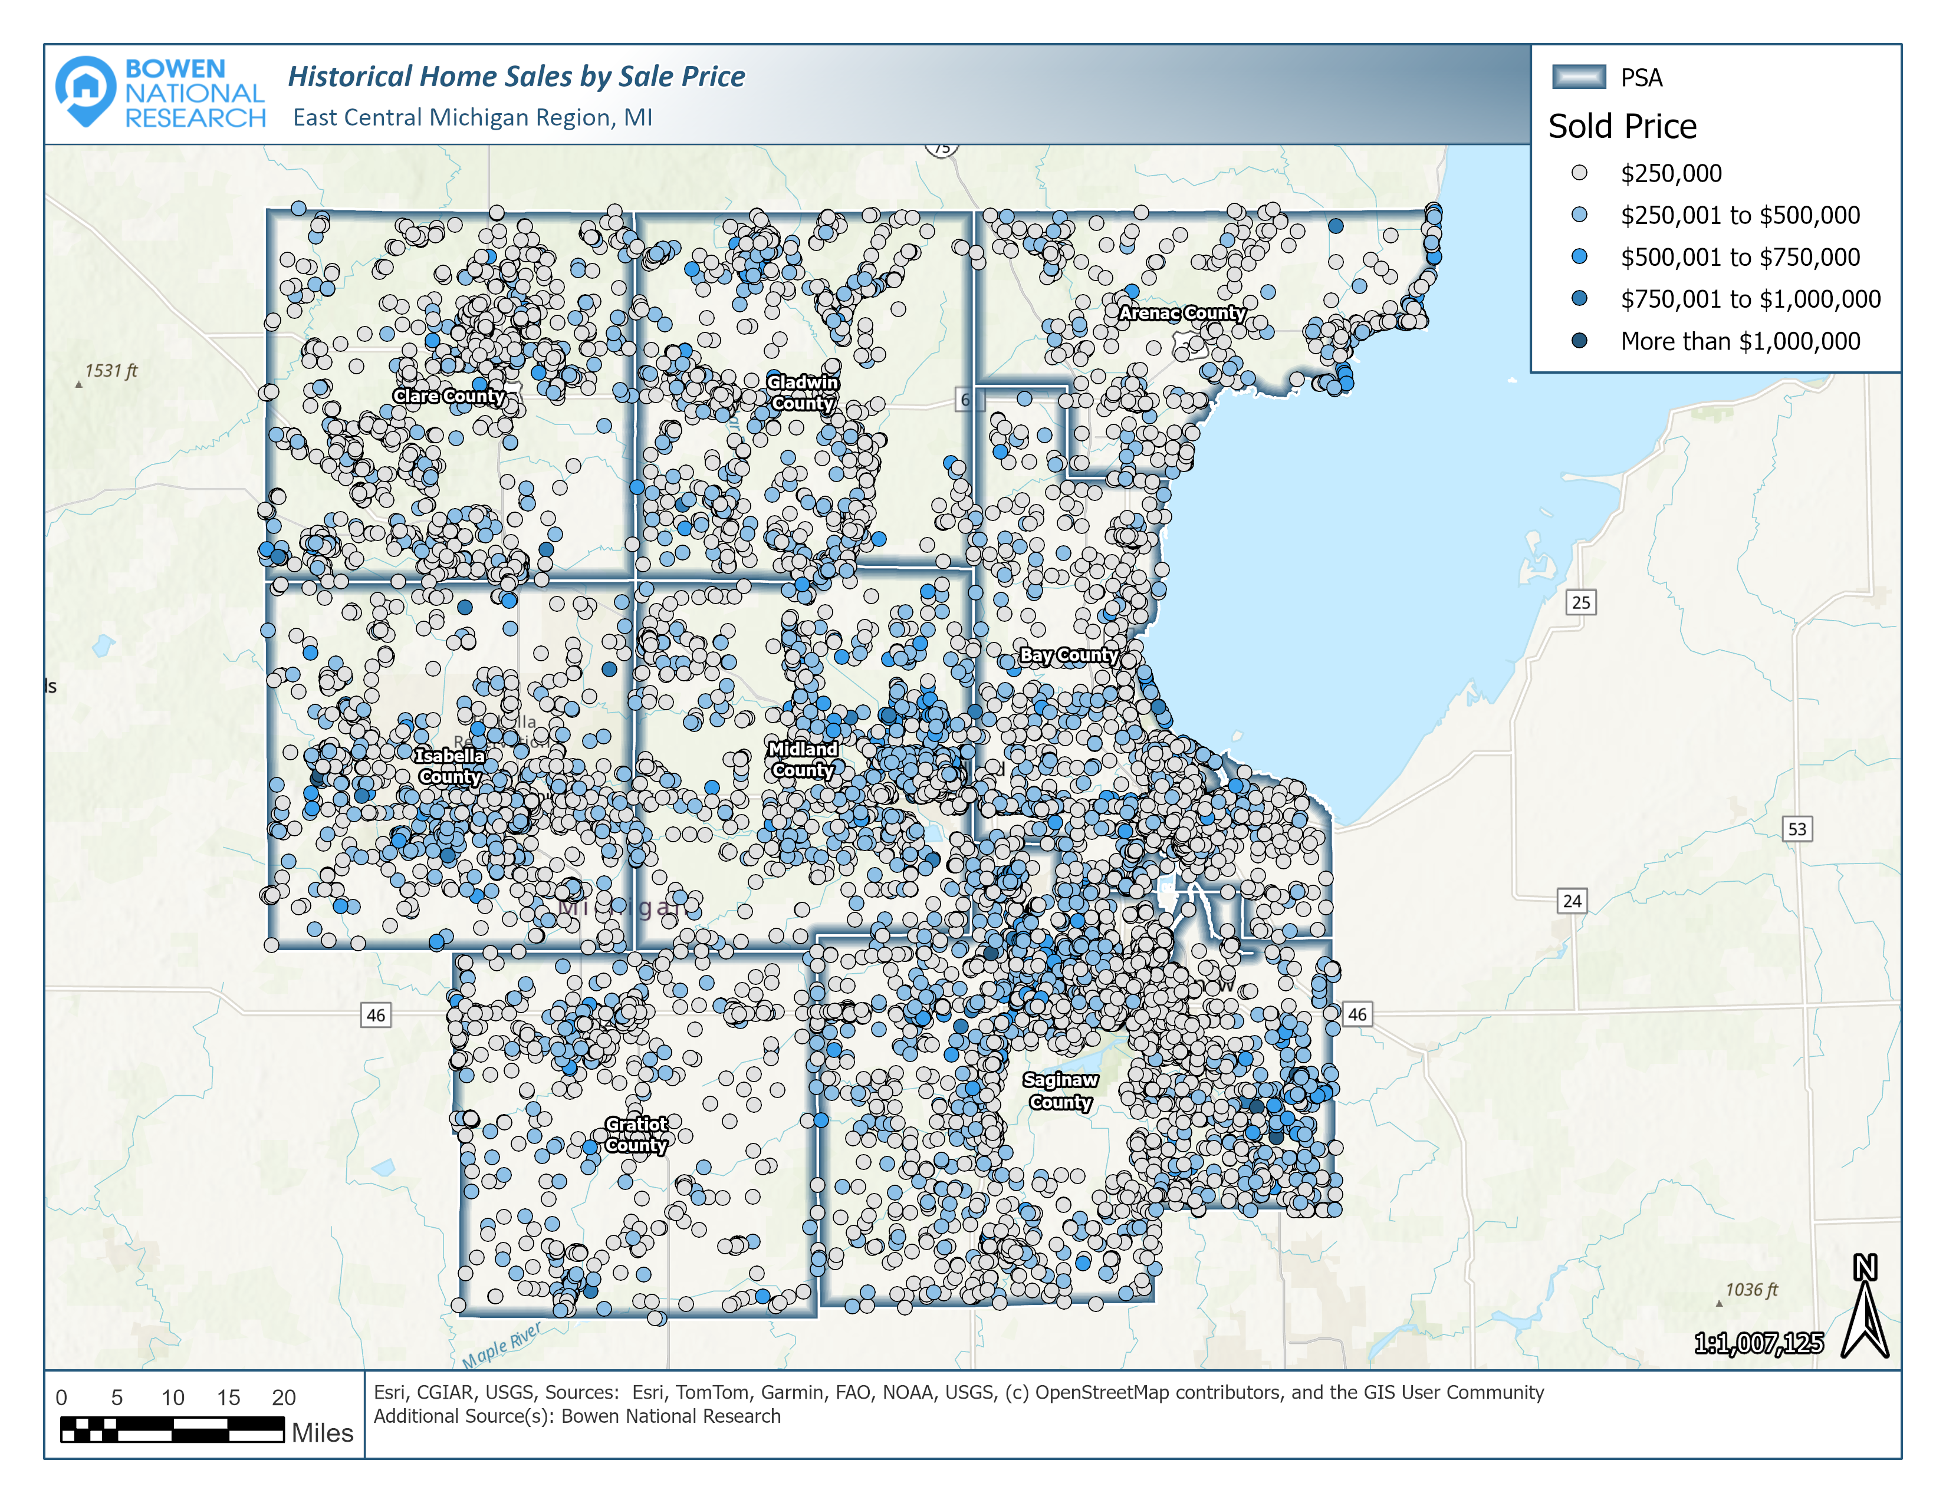
Home Sales (2022-2025)
Homes priced below $200,000 represented the vast majority of sales in all eight counties, with Clare County (74.4%) and Bay County (71.6%) reporting the highest shares.
75% of sales priced at $300k+

Slide 18
Available Home Listings by Price
Over one-half (50.7%) of the available for-sale homes in the region are priced below $200,000, but these homes are typically much older than the higher-priced product.

Slide 19
Available Home Listings by Submarket & List Price
The median list price of the 876 available homes in the region is $199,700. The lowest median list price ($174,000) among the study areas is in Clare County while the highest median list price ($235,000) is in Midland County.
 | Available For-Sale Housing – Region G (As of March 19, 2025)
 | Total Units | % Share of Region | Availability Rate / MSI | Median List Price | Average Square Feet | Average Year Built | Average Days on Market
Arenac | 42 | 4.8% | 0.7% / 3.2 | $191,250 | 1,532 | 1973 | 135
Bay | 126 | 14.4% | 0.4% / 1.5 | $199,900 | 1,581 | 1953 | 71
Clare | 119 | 13.6% | 1.1% / 3.0 | $174,000 | 1,297 | 1974 | 121
Gladwin | 87 | 9.9% | 0.9% / 2.9 | $221,900 | 1,462 | 1977 | 96
Gratiot | 64 | 7.3% | 0.6% / 2.3 | $176,750 | 1,670 | 1951 | 71
Isabella | 105 | 12.0% | 0.7% / 2.3 | $224,000 | 1,628 | 1969 | 112
Midland | 53 | 6.0% | 0.2% / 1.4 | $235,000 | 1,973 | 1970 | 74
Saginaw | 280 | 32.0% | 0.5% / 1.8 | $187,450 | 1,663 | 1956 | 76
Region | 876 | 100.0% | 0.5% / 2.0 | $199,700 | 1,590 | 1963 | 90
Source: Redfin.com & Bowen National Research
Counties with an availability rate and an MSI that are below the healthy ranges are likely at risk of rapid increases in home prices and/or limited household growth.

Slide 20
2-Br. Fair Market Rent: $942
Median List Price: $199,700
Wages and Housing Affordability for Top 35 Occupations by Share of Labor Force (East Central Michigan Prosperity Region)
Occupation Sector, Title & Wages* |  |  |  |  | Housing Affordability**
Sector Group (Code) | Labor Force Share | Occupation Title | Annual Wages |  | Max. Monthly Rent |  | Max. Purchase Price
 |  |  | Lower Quartile | Median | Lower Quartile | Median | Lower Quartile | Median
Sales Occupations (41) | 3.4% | Retail Salespersons | $26,520 | $30,010 | $663 | $750 | $88,400 | $100,033
 | 2.5% | Cashiers | $25,680 | $28,140 | $642 | $704 | $85,600 | $93,800
 | 0.8% | First-Line Supervisors of Retail | $35,000 | $44,390 | $875 | $1,110 | $116,667 | $147,967
 | 0.8% | Sales Representatives, Wholesale | $47,330 | $65,670 | $1,183 | $1,642 | $157,767 | $218,900
Food Preparation/ Serving (35) | 3.0% | Fast Food and Counter Workers | $25,630 | $27,590 | $641 | $690 | $85,433 | $91,967
 | 1.8% | Waiters and Waitresses | $27,820 | $34,430 | $696 | $861 | $92,733 | $114,767
 | 1.0% | Cooks, Restaurant | $29,000 | $32,040 | $725 | $801 | $96,667 | $106,800
 | 0.8% | First-Line Supervisors, Food Prep | $31,010 | $36,550 | $775 | $914 | $103,367 | $121,833
Office and Administrative Support (43) | 2.1% | Customer Service Representatives | $30,010 | $36,680 | $750 | $917 | $100,033 | $122,267
 | 2.0% | Office Clerks, General | $33,620 | $39,720 | $841 | $993 | $112,067 | $132,400
 | 1.0% | Secretaries/Admin. Assistants, | $34,530 | $39,670 | $863 | $992 | $115,100 | $132,233
 | 0.9% | Bookkeeping/Accounting Clerks | $36,750 | $43,150 | $919 | $1,079 | $122,500 | $143,833
 | 0.7% | First-Line Supervisors of Office | $46,660 | $56,780 | $1,167 | $1,420 | $155,533 | $189,267
 | 0.7% | Receptionists/Information Clerks | $29,850 | $34,470 | $746 | $862 | $99,500 | $114,900
 | 0.7% | Medical Secretaries | $34,490 | $37,150 | $862 | $929 | $114,967 | $123,833
Transportation Material Moving (53) | 1.9% | Stockers and Order Fillers | $29,630 | $31,990 | $741 | $800 | $98,767 | $106,633
 | 1.5% | Heavy/Tractor-Trailer Drivers | $44,040 | $49,100 | $1,101 | $1,228 | $146,800 | $163,667
 | 1.2% | Freight and Material Movers | $31,030 | $35,160 | $776 | $879 | $103,433 | $117,200
 | 0.6% | Light Truck Drivers | $29,000 | $36,720 | $725 | $918 | $96,667 | $122,400
Education, Training, and Library (25) | 1.0% | Elementary School Teachers | $48,600 | $62,450 | $1,215 | $1,561 | $162,000 | $208,167
 | 1.0% | Teaching Assistants | $28,230 | $29,310 | $706 | $733 | $94,100 | $97,700
 | 0.7% | Secondary School Teachers | $51,020 | $64,710 | $1,276 | $1,618 | $170,067 | $215,700
Continued on next slide.

Slide 21
2-Br. Fair Market Rent: $942
Median List Price: $199,700
Wages and Housing Affordability for Top 35 Occupations by Share of Labor Force (East Central Michigan Prosperity Region)
Occupation Sector, Title & Wages* |  |  |  |  | Housing Affordability**
Sector Group (Code) | Labor Force Share | Occupation Title | Annual Wages |  | Max. Monthly Rent |  | Max. Purchase Price
 |  |  | Lower Quartile | Median | Lower Quartile | Median | Lower Quartile | Median
Healthcare (29, 31) | 2.8% | Registered Nurses | $80,190 | $82,390 | $2,005 | $2,060 | $267,300 | $274,633
 | 1.4% | Nursing Assistants | $34,990 | $36,590 | $875 | $915 | $116,633 | $121,967
 | 0.8% | Medical Assistants | $35,820 | $37,530 | $896 | $938 | $119,400 | $125,100
Management (11,13) | 1.9% | General and Operations Managers | $56,130 | $82,180 | $1,403 | $2,055 | $187,100 | $273,933
 | 0.9% | Accountants and Auditors | $58,830 | $72,740 | $1,471 | $1,819 | $196,100 | $242,467
Engineering (17) | 0.6% | Mechanical Engineers | $77,820 | $93,660 | $1,946 | $2,342 | $259,400 | $312,200
Construction/ Installation/ Repair (47, 49) | 0.9% | Maintenance and Repair Workers | $34,040 | $39,580 | $851 | $990 | $113,467 | $131,933
 | 0.7% | Construction Laborers | $37,330 | $45,910 | $933 | $1,148 | $124,433 | $153,033
 | 0.6% | Electricians | $46,500 | $60,510 | $1,163 | $1,513 | $155,000 | $201,700
 | 0.6% | Automotive Service Technicians | $35,960 | $46,810 | $899 | $1,170 | $119,867 | $156,033
Bldg./Grounds Maint. (37) | 1.5% | Janitors and Cleaners | $28,940 | $31,850 | $724 | $796 | $96,467 | $106,167
 | 0.8% | Landscaping and Groundskeeping | $31,390 | $36,090 | $785 | $902 | $104,633 | $120,300
 | 0.6% | Maids and Housekeeping | $28,310 | $32,430 | $708 | $811 | $94,367 | $108,100
Single-income households with workers employed in some of the most common occupations in the region likely struggle to afford rental and/or for-sale housing.

Slide 22
Housing Gap Estimates 2024-2029 (Rental Housing)
Between 2024 and 2029, Region G has an overall housing gap of 7,554 rental units. While there is a notable gap among each affordability level, the greatest gap is for the most affordable product which has rents generally priced at $1,256 or lower.
Region G |  | AMHI Level |  |  |  | Total Rental Gap
 |  | ≤ 60% | 61%-80% | 81%-120% | 121%+ | Number of Units | Regional Share
Region Total | Units | 3,809 | 1,790 | 1,469 | 486 | 7,554 | 100.0%
 | Share | 50.4% | 23.7% | 19.4% | 6.4% | 100.0% | -
AMHI – Area Median Household Income

Slide 23
Housing Gap Estimates by Submarket 2024-2029 (Rental) – 7,554 Units Needed

Slide 24
Housing Gap Estimates 2024-2029 (For-Sale Housing)
Between 2024 and 2029, Region G has an overall housing gap of 23,577 for-sale units. While gaps exist among all affordability levels, the greatest gap is for housing affordable to households earning between 81% and 120% of AMHI that can afford housing generally priced between $218k & $335k.
Region G |  | AMHI Level |  |  |  | Total For-Sale Gap
 |  | ≤ 60% | 61%-80% | 81%-120% | 121%+ | Number of Units | Regional Share
Region Total | Units | 389 | 3,936 | 12,554 | 6,698 | 23,577 | 100.0%
 | Share | 1.6% | 16.7% | 53.2% | 28.4% | 100.0%
AMHI – Area Median Household Income

Slide 25
Housing Gap Estimates by Submarket 2024-2029 (For-Sale) – 23,577 Units Needed

Slide 26
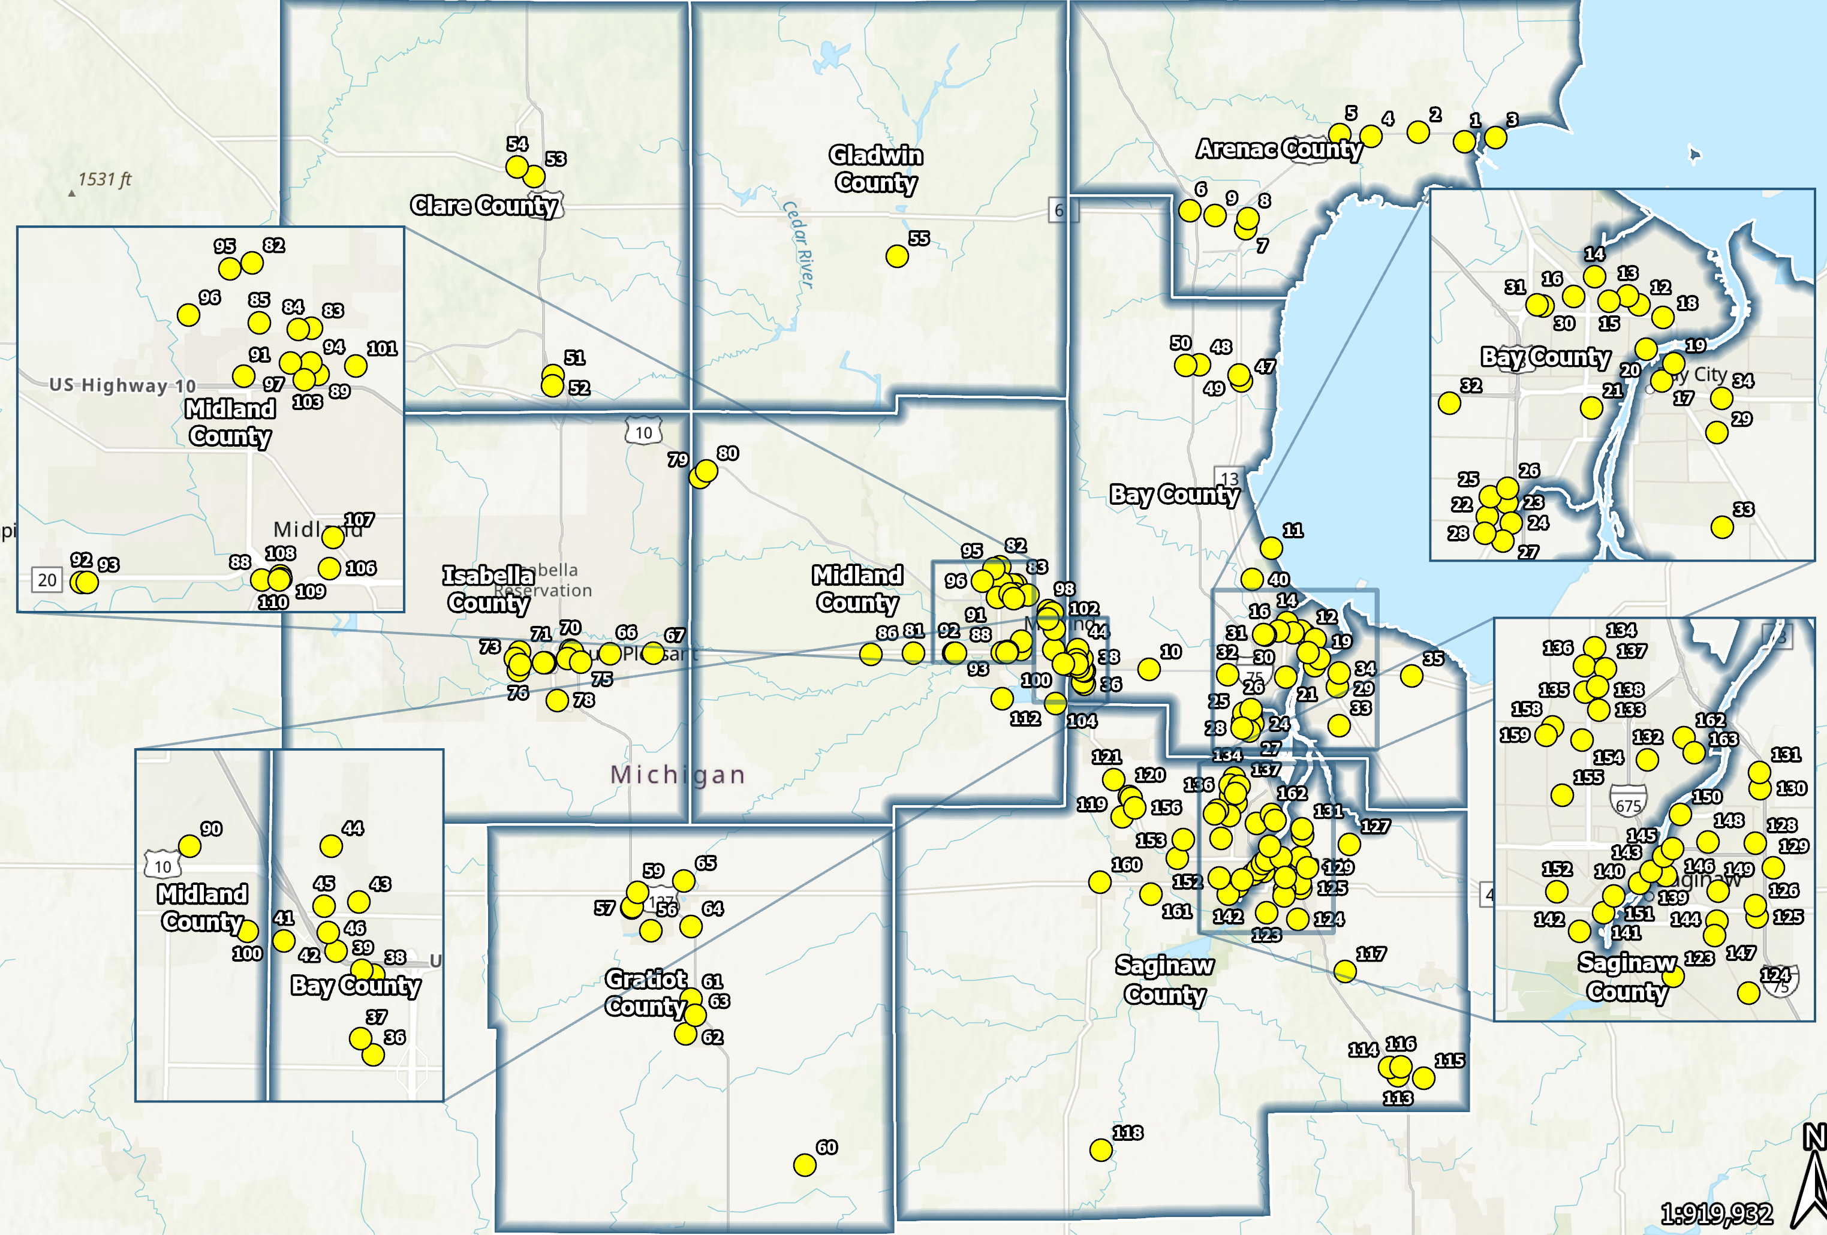
Development Opportunities (Potential Sites)
163 Sites Identified within the Region
Sites Contain
3,040 acres of land.
1,287,000 square feet of existing structure area.
30 properties have over 30 acres of land.
Not all properties containing an existing building or structure may be feasible to redevelop as housing due to overall age, condition, or structural makeup.

Slide 27
Community Input – Stakeholder Survey
Category | Top Needs / Issues | Consensus
Housing Needs by Price Point | For-Sale Housing (Less than $150,000) Rental Housing (Less than $500/month) Senior Care (Income/Assets <$25,000) Rental Housing ($500-$999/month) | 87.7* 86.5* 84.0* 83.0*
Common Housing Issues | Rent Affordability Limited Availability Home Purchase Affordability | 85.6% 80.5% 62.7%
Priority by Construction Type | Repair/Renovation/Revitalization of Existing Housing New Construction Clear Blighted/Unused Structures for New Development | 87.5* 76.1* 72.2*
Common Residential Barriers | Cost of Labor/Materials Cost of Infrastructure Development Costs Cost of Land Financing | 81.4% 58.5% 53.4% 50.9% 50.9%
Best Options to Reduce Barriers | Housing Gap/Bridge Financing Government Assistance with Infrastructure Collaboration between Public and Private Sectors | 48.7% 43.6% 38.5%
Housing Impact on Local Residents | Limits the Ability of Families to Grow/Thrive Causes People to Live in Substandard Housing Prevents Seniors from Housing That Fits Their Needs Causes People to Live in Housing They Cannot Afford | 87.6* 85.5* 82.3* 81.2*
Renter Assistance Priorities | Renter Security Deposit Assistance Housing Resource Center Properties that Meet Code/Life Safety Compliance Credit Repair Assistance | 55.3% 49.1% 46.5% 44.7%
146 Respondents Participated
Nonprofit Groups
Housing Developer/Builder
Government/Elected Officials
Housing Authority
Landlord/Property Management
Education
Social/Supportive Services
Agency on Aging/Senior Services
Elected Officials
Housing Organization
Economic Development
Chambers of Commerce
Faith Organizations
*Weighted Score on Priorities

Slide 28
Community Input – Employer Survey
47 Respondents Participated
Manufacturing/Industrial
Public/Government
Education
Hospitality/Lodging
Recreation
Professional
Utilities
Healthcare
Other
Category | Top Needs / Issues | Consensus
Housing Issues/Challenges Experienced by Employees | Lack of Available Housing Unaffordable Rental Housing Unaffordable For-Sale Housing | 67.4% 50.0% 41.3%
Impacts for Employers Resulting from Housing Issues | Difficulty Attracting Employees Difficulty Retaining Employees Unknown | 58.7% 39.1% 30.4%
Likelihood of Increasing Number of Employees if Adequate Housing Available | Much More Likely Somewhat Likely Not Likely/No Impact | 30.4% 26.1% 26.1%

Slide 29
Community Input – Resident Survey
407 Respondents Participated
Category | Top Needs / Issues | Consensus
Housing Issues Experienced | Cost Burdened (Paying 30% or More of Income Toward Housing Cost) Outdated Housing Did Not Have Sufficient Deposit or Down Payment | 26.6% 16.8% 8.3%
Issues Adversely Impacting Housing Market | High Prices/Rents Not Enough Housing/Rental Options (Few Vacancies) Excessive/Rising Utility Costs Mismatch Between Local Jobs/Wages and Housing Costs Property/Income Taxes | 51.3% 38.8% 30.3% 28.4% 20.0%
Housing Types Needed | For-Sale Housing (Less than $200,000) Rental Housing (Less than $1,250/month) For-Sale Housing ($200,000 to $299,999) | 90.5* 88.5* 38.6*
Housing Styles Needed | Ranch Homes/Single Floor Plan Units Modern Move-In Ready Single-Family Homes Apartments | 83.2* 83.0* 67.3*
Housing Need by Household Group | Millennials (Ages 25 to 44) Young Persons (Under Age 25) | 68.2% 11.5%
Interest in Relocating (Non-Residents) | Interested in Relocating to Region | 70.3%
County of Relocation Interest | Bay County Midland County Saginaw County | 23.4% 18.8% 17.2%
*Weighted Score on Priorities

Slide 30
Recommended Housing Strategies
Refine the Existing Regional Housing Plan based on Findings of this Housing Needs Assessment
Establish/Reassess Entity Responsible for Leading Long-Term Housing Efforts in the Region and Within Individual Counties/Municipalities and Expand Local Organizational Capacity to Assist the Area’s Housing Efforts
Identify and Leverage Resources to Increase Housing Production and Impact of Housing Initiatives
Utilize Resources to Help Stabilize Housing Situations and Secure Housing for the Most Vulnerable Households
Develop Education and Outreach Campaign to Help Support Housing Initiatives
Market the Region’s Residential Development Opportunities to Encourage Residential Development, including Leveraging Data Related to Potential Residential Development Sites and Potential Development Partners Outlined in this Report
Create Housing Services Resource Center or Build Upon Existing Tools

Slide 31
Questions?
Contact:
Patrick Bowen
Bowen National Research
patrickb@bowennational.com
614-833-9300
www.bowennational.com

